Slide 1

Computer Architecture and Operating Systems CS 3230: Operating System Section Lecture OS-9 Virtual Memory
Department of Computer Science and Software Engineering
University of Wisconsin-Platteville

Slide 2
Outlines
Introduction
Demand Paging
Page Fault
Page Replacement Algorithms
Thrashing

Slide 3
Introduction
Virtual Memory: the technique that allows to execute processes that may not be completely in physical memory
Only a part of the program needs to be in memory for execution
Advantages:
Separation of user logical memory from physical memory
Logical address space can therefore be much larger than physical address space
Allows address spaces to be shared by several processes
More users
Allows for more efficient process creation
Faster response ( only the needed page(s) should be loaded in the memory)
Less memory needed

Slide 4
Virtual Memory: How?
Can be implemented using:
Demand Segmentation – only the segments that are currently in use are brought into memory
Demand Paging – only the necessary pages are brought in

Slide 5
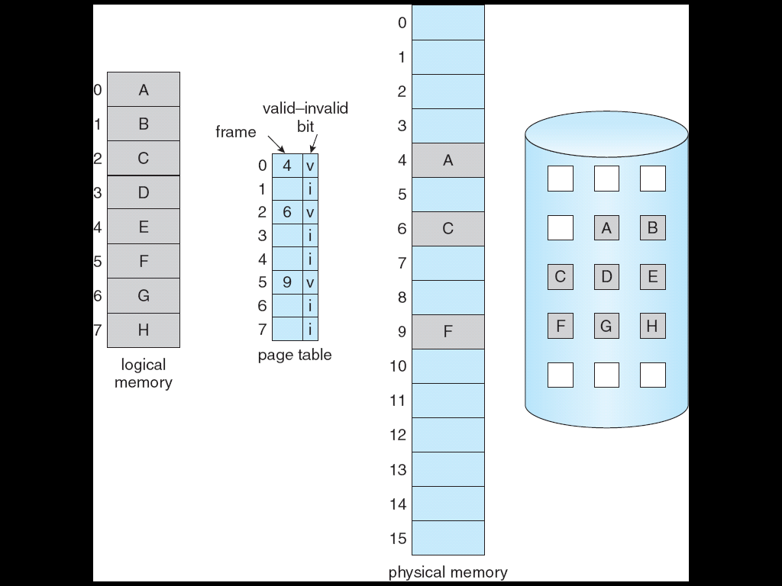
Demand Paging
Bring a page into memory only when it is needed
While not in use the pages are stored on the Disk Backing Store
Backing Store : fast disk large enough to accommodate copies of all memory pages for all users
Page table indicates
whether the page is
in memory or in
backing store

Slide 6
Page Fault
If a process requests a page that is not in memory
Page fault trap is generated
Control is passed to OS
The faulted process is suspended (another process may be started while it waits)
A request to fetch the page is generated
When page is in memory , then the page table is updated
validation bit = 1
The instruction that caused page fault is re-executed
Page fault handling should be invisible to user process

Slide 7
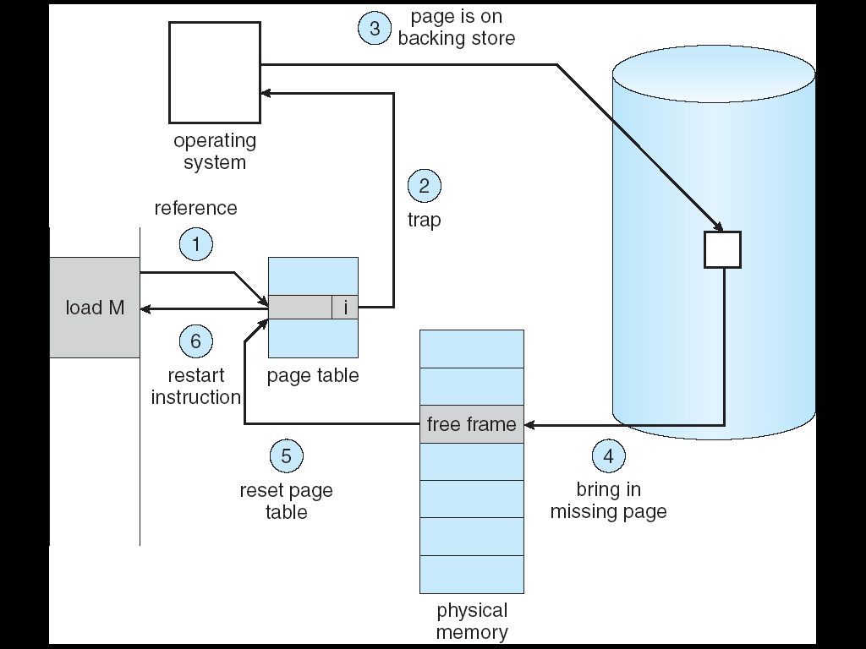
Handling Page Faults
OS looks at another table to decide:
Invalid reference ⇒ abort
Just not in memory
Handling Procedure

Slide 8
Handling Page Faults
What happens if there is no free frame?
Page Replacement – find some page in memory, but not really in use, swap it out.

Slide 9
Performance of Demand Paging
Page Fault Rate (P) : 0 ≤ p ≤ 1.0
Effective Access Time (EAT)
EAT = (1 – p) x memory access
+ p (page fault overhead
+ [swap page out ]
+ swap page in
+ restart overhead)
Example:
Memory access time = 1 microsecond , P=50%
Swap Page Time = 10 msec , restart overhead=0
Find EAT?

Slide 10
Copy-on-Write
After fork() : child process obtains a copy of parent’s address space
Virtual memory allows copy-on-write benefit during process creation
Allows both parent and child processes to initially share the same pages in memory
If either process modifies a shared page
Create independent copy (modified pages are only copied)
Free pages are allocated from a pool of zeroed-out pages
Note that this way parent and child will automatically share code as well as read-only sections of data

Slide 11
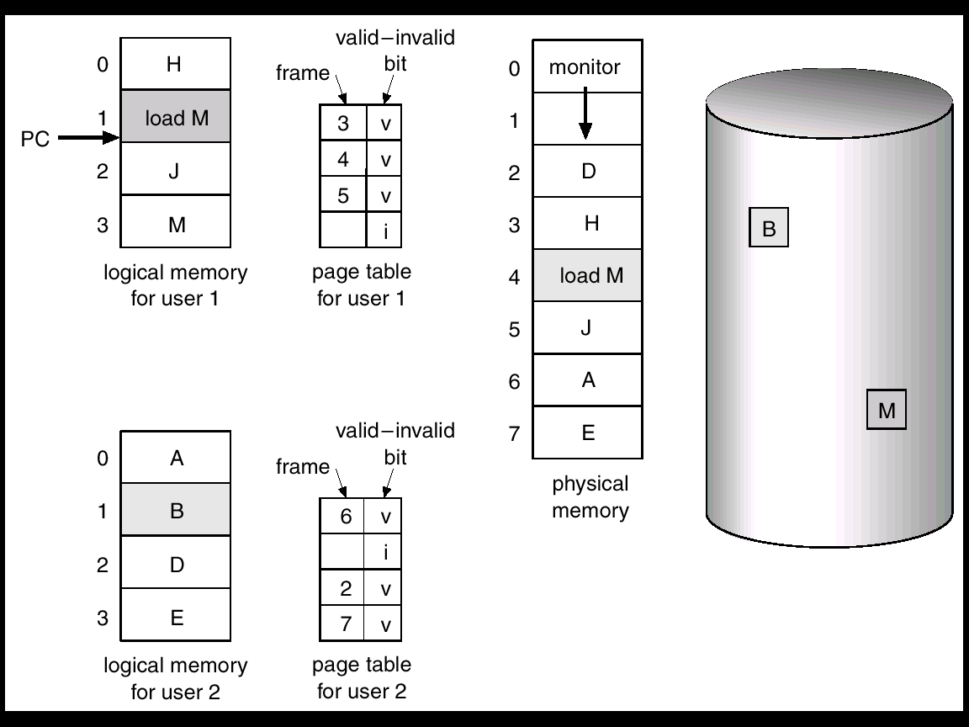
Page Replacement
What happens if a process requests a page and there are no free frames?
If there is no free frame, use a page replacement algorithm to select a victim frame/page
Example: need for page replacement

Slide 12
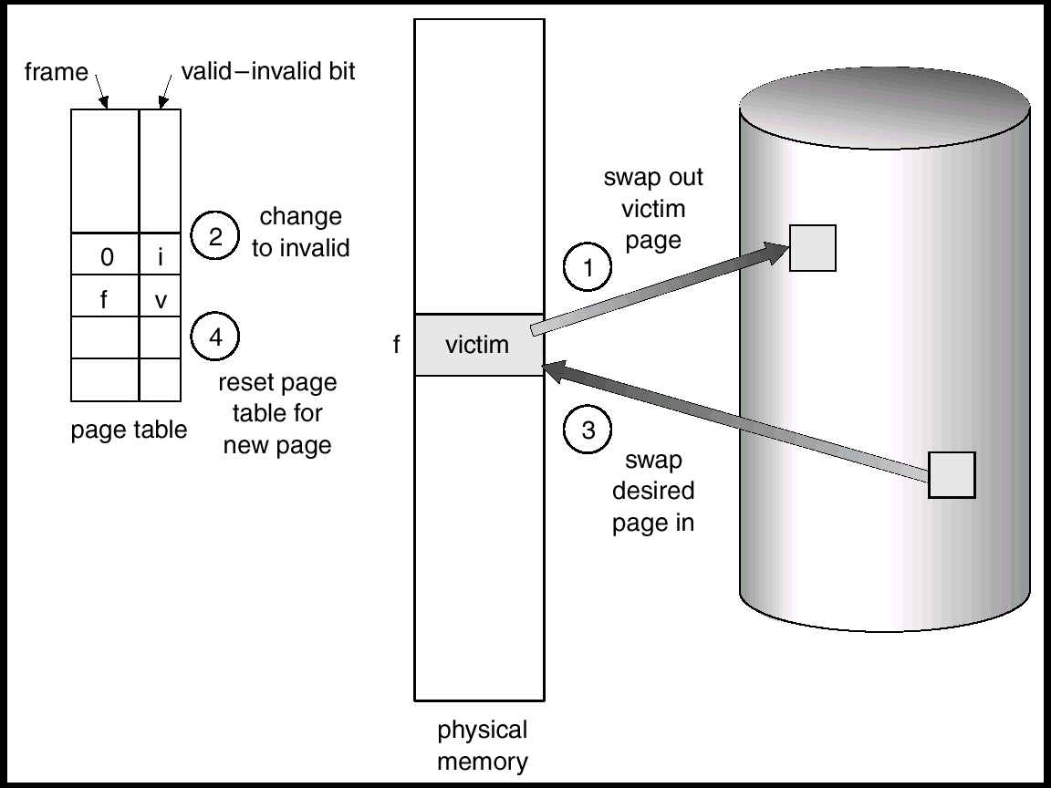
Page Replacement Steps

Slide 13
Clean/Dirty Bit
Problem: swapping out victim page is an overhead
Solution: only modified pages are written to disk
Approach:
clean/dirty bit is associated with every in-memory page
if the page has been modified – it is dirty and has to be written to disk
if the page has not been modified - (it is the same as it’s copy in the backing store) - it can be just discarded and replaced

Slide 14
Page Replacement Algorithms
Page replacement algorithms
FIFO - simplest to implement, performance is not always good
Optimal - replace the page that will not be used for the longest period of time - cannot be implemented (requires future knowledge)
Least Recently Used (LRU) - replace the least recently used page
Counting algorithms
Goal:
Want lowest page-fault rate
Algorithm input:
Order of page accessing
This order is represented by a reference string
Reference string example:
1, 2, 3, 4, 1, 2, 5, 1, 2, 3, 4, 5

Slide 15
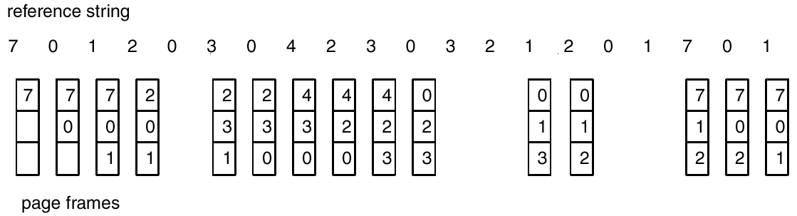
FIFO Page Replacement

Slide 16
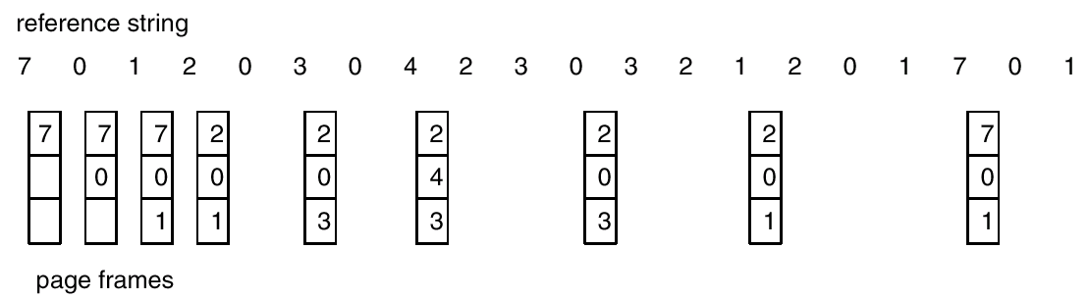
Optimal Algorithm
Replace page that will not be used for longest period of time
Problem: How do you know this?

Slide 17
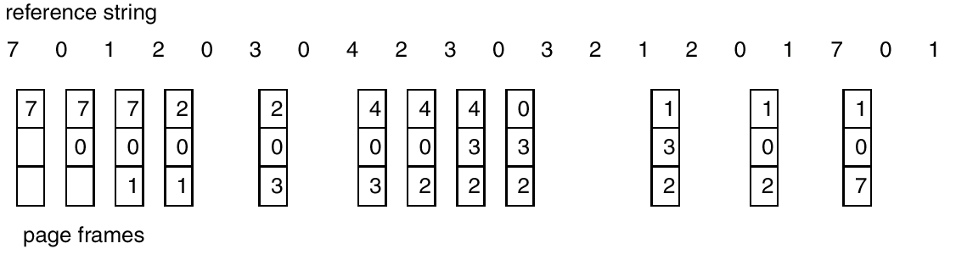
LRU Algorithm

Slide 18
LRU Algorithm: Implementation
Approach1: counter implementation
Every page entry has a counter; every time page is referenced through this entry, copy the clock into the counter
When a page needs to be changed, look at the counters to determine which are to change
Approach2: stack implementation
keep a stack of page numbers in a double link form
Page referenced: move it to the top
No search for replacement (victim page to be replaced)

Slide 19
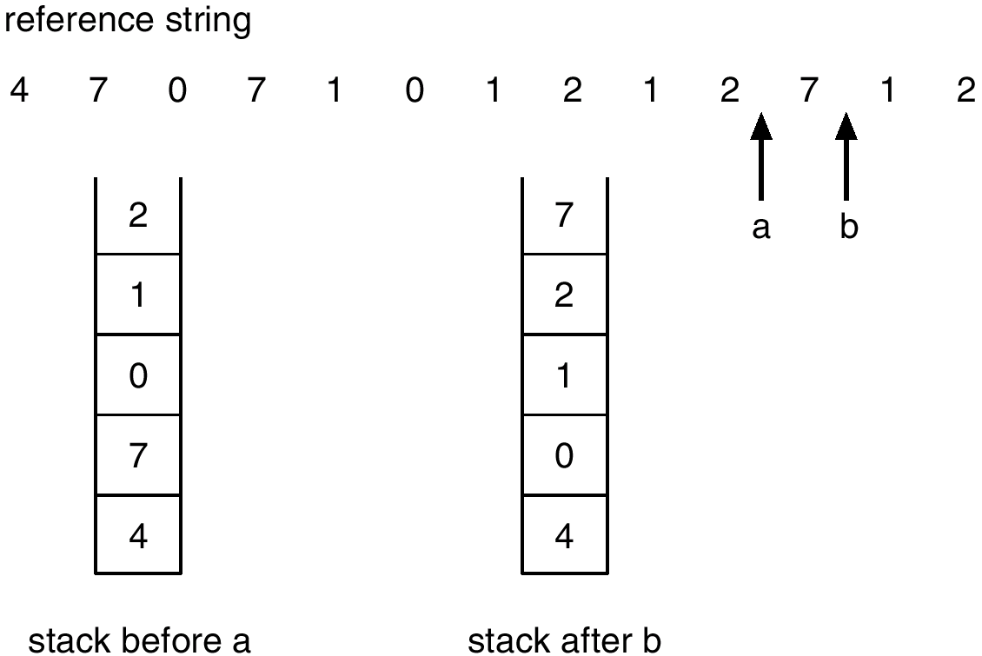
LRU Algorithm: Implementation
Example: use of a stack to record the Most Recent Page References

Slide 20
LRU Approximation Algorithm
Reference bit
With each page associate a bit, initially = 0
When page is referenced bit set to 1
Second chance
Need reference bit
Clock replacement
If page to be replaced (in clock order) has reference bit = 1. then:
set reference bit 0
leave page in memory
replace next page (in clock order), subject to same rules

Slide 21
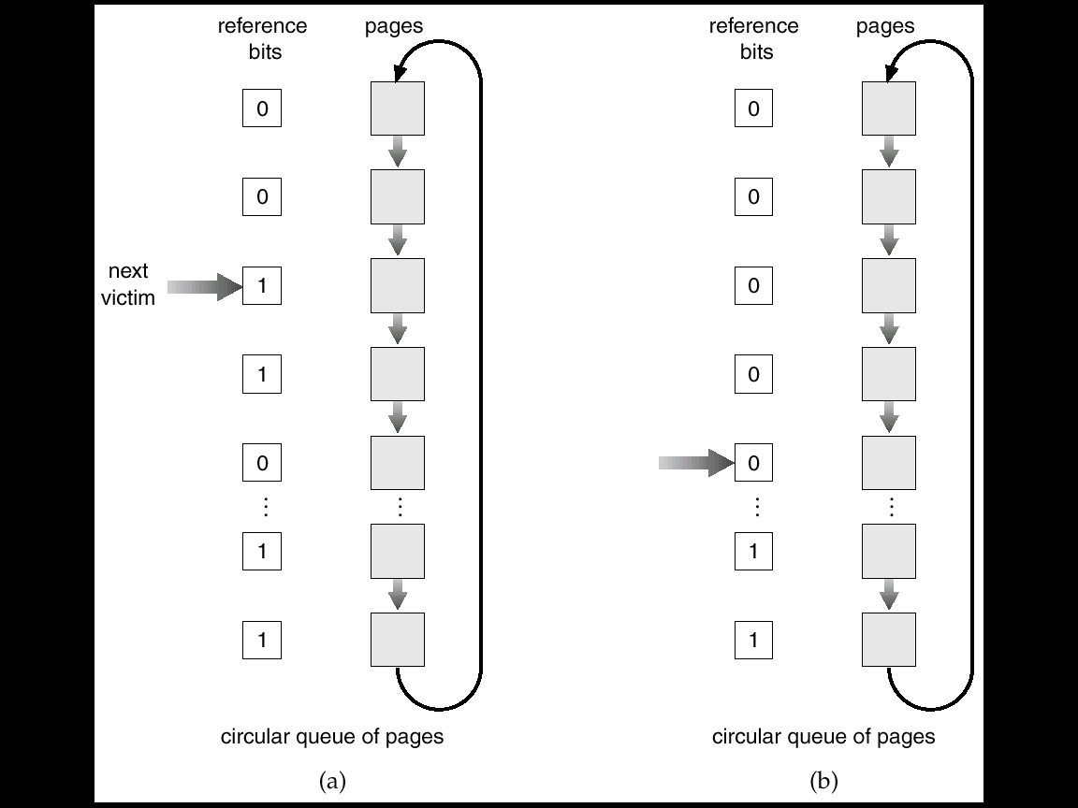
LRU Approximation Algorithm

Slide 22
Counting Algorithms
Keep a counter of the number of references that have been made to each page
LFU Algorithm: replaces page with smallest count
MFU Algorithm: based on the argument that the page with the smallest count was probably just brought in and has yet to be used

Slide 23
Global vs. Local Replacement
Global Replacement
Process selects a replacement frame from the set of all frames
One process can take a frame from another.
Local Replacement
Each process selects from only its own set of allocated frames

Slide 24
Allocation of Frames
Assume the memory is M frames, and we have N processes
How many frames does each process get?
Frame allocation algorithms:
Equal Allocation - each gets M / N frames
Proportional Allocation - number depends on size and priority

Slide 25
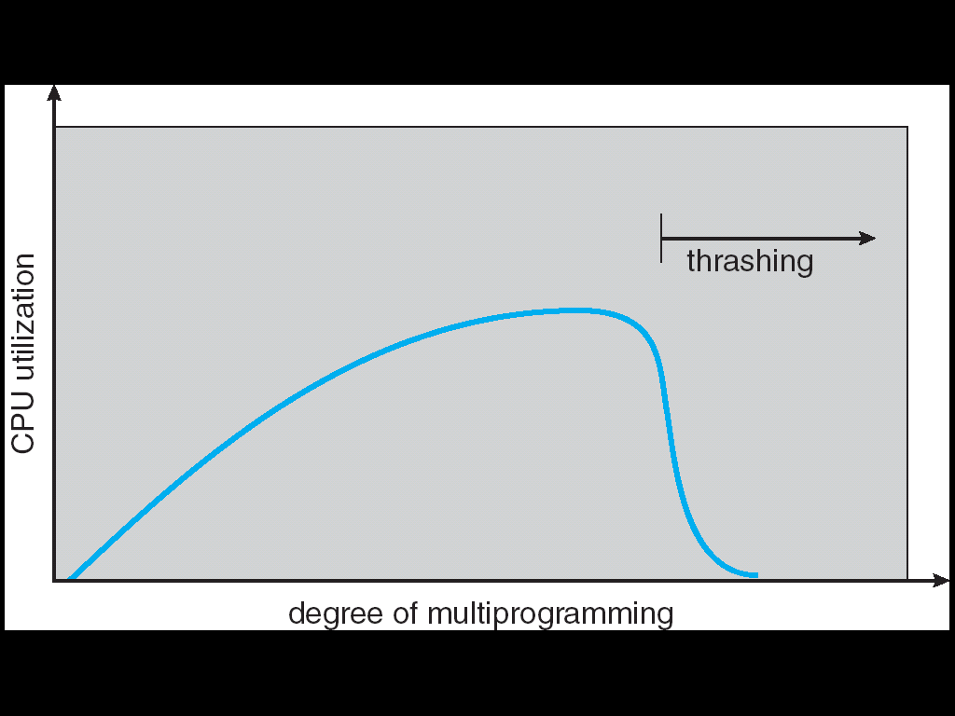
Thrashing
If a process does not have “enough” pages, the page-fault rate is very high. This leads to:
Low CPU utilization
Operating system thinks that it needs to increase the degree of multiprogramming
Another process added to the system
Thrashing ≡ a process is busy swapping pages in and out

